Slide 1


Virtual labs: Concept to Usage
Sasikumar M
Executive Director, CDAC Mumbai
sasi@cdac.in

Slide 2
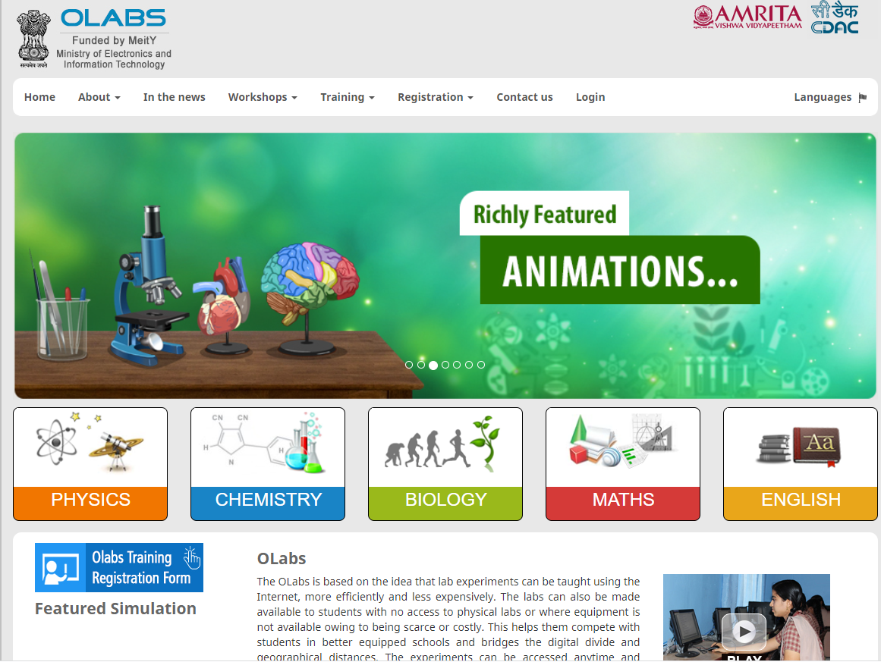
OLabs – virtual labs for schools
Over 200 virtual labs covering Science, Maths and English for school students now available.
Freely accessible on the web (olabs.edu.in), and through Diksha.
Coming: A suite of about 600 more in the next couple of years.
Physics
Chemistry
Biology
Mathematics
English
Notes:
Subject specific sessions from tomorrow – will discuss general today.

Slide 3
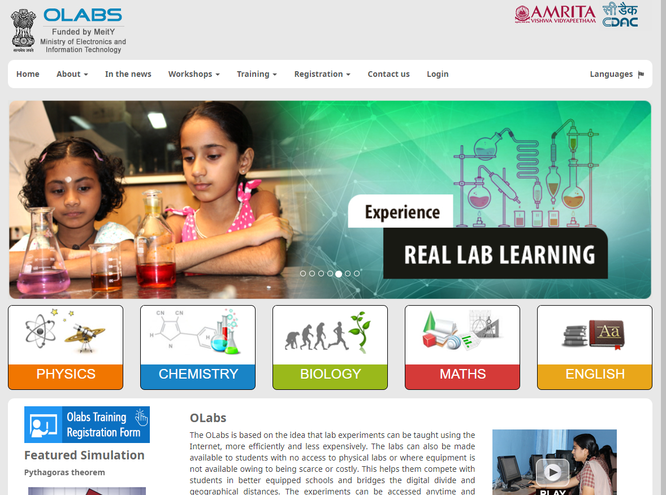
Landing page of
OLabs
On Diksha, the labs will also be linked to the subject/topic directly.

Slide 4
Labs in education…
Laboratories recognized as important devices in the learning process:
  Hands on feel of the lessons learned.
  Connecting the theory to the real-life.
  Focus on experiment as a key paradigm in science.
  Better internalization of the content
    Tell me, I will forget;
    Show me, I may remember;
    Involve me, I will understand.
Active Learning

Slide 5
But….
Cost and space requirements for physical infrastructure and equipments.
Cost of raw material.
Limited access, that too often in group mode.
Support for divyang students?
Not all activities amenable to physical labs:
  Pendulum with gravity change
  Dangerous reactions
  Time-taking tasks and very fast paced phenomena

Slide 6
Virtual labs
Virtual labs and remote labs to the rescue?…
Virtual labs: simulation labs. Usually computer simulation of important aspects of the lab.
Remote labs: expensive equipments can be manipulated remotely; enables sharing of such resources.
One of the recommendations in the NEP 2020

Slide 7
Virtual labs
Aka simulation labs (e.g. OLabs).
Unconstrained availability; trivial cost once developed.
  Development cost can be high!
Simulations attempt to mimic the reality – but not actually the reality
  There are boundaries ignored (spring’s linearity region)
  Simplifications introduced
  Can manipulate the timescale (slow down very fast reactions, speed up the very slow)
  There are also new opportunities (pendulum in Moon or Jupiter)
Can be a very powerful instructional device
  See as amplifiers, not replacements!

Slide 8
Adopting virtual labs
Provide a comprehensive eco-system to reduce time to use.
1
Understand the pedagogical aspects and adopt relevant usage pattern.
2
Provide rich set of affordances and guidance.
3
Integrate into the curriculum.
4

Slide 9

Eco-system
The core simulator
Theory relevant to the lab
Understanding of the process and its implications
Auxiliary requirements: plot, measurement and recording, etc
Review questions, references

Slide 10
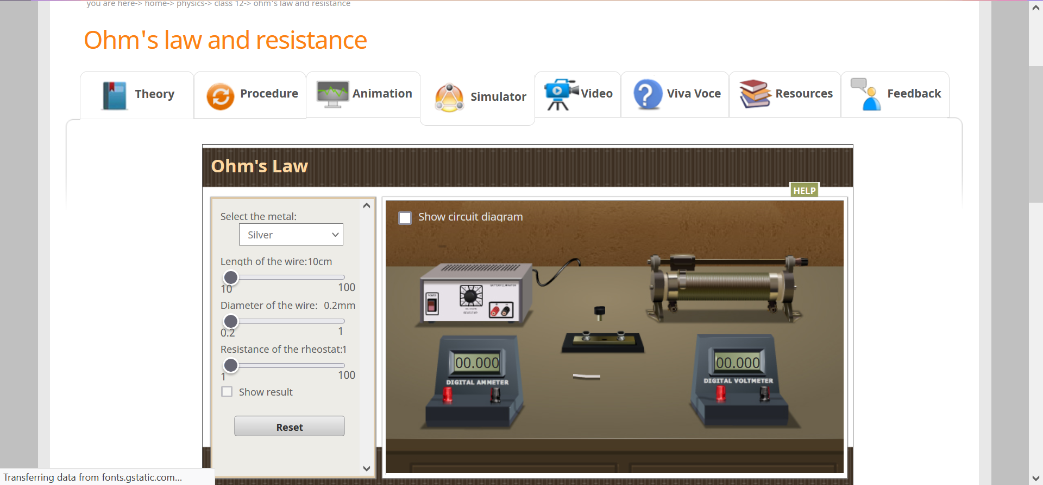
OLabs: A view of a lab
Affordances

Slide 11
OLabs Ready to Use
Compared to the many simulators available online, Olabs provide a complete eco-system for the lab.
Consistency in terminology across the tabs.
Compliance with the NCERT curriculum.
Content reviewed and approved by CBSE teachers.
High degree of interactivity for the learner and multiple affordances.

Slide 12
Usage mode-1
Before the physical lab….
Usually students have no idea of what to expect in the lab, till they reach there.
Being prepared will help to use the limited lab time more effectively.
OLabs mimics the experimental setup with high fidelity.
Use the virtual lab as a preparatory ground before the lab.

Slide 13
Usage mode-2
After the physical lab
Physical labs provide limited options to explore..
  due to resource constraints
  and time constraints.
In the lab environment, adequate time to reflect may not be there.
Ask the learner to explore the virtual lab in more detail and try out more scenarios.
Use reflection in the class, with specific scenarios.

Slide 14
Usage mode-3
As an instructional device….
Explaining concepts like hooks law, focus length of a lens, etc hard without a lab setup.
Olabs can function as a replica of lab setup for this purpose.
Demonstrate the intended behavious using Olabs.
Use affordances provided to try select use cases.
Encourage the learners to try them out on their own.

Slide 15
Usage mode-4
For active learning strategies…
Active learning strategies like flipped classroom require mechanisms to engage a class without lectures.
A lab setup replicated in the classroom can provide a fertile ground…
Stop the experiment arbitrarily and ask learners to predict what happens?
  What happens if a weight of 25Kg is put on the spring in Hook’s law?
  What happens to image, as the candle moves closer to the focal point of a lens?
Deepens learning and encourages reflection.

Slide 16
Usage mode-5
When there is no physical lab – e.g. pandemic, lack of infra.
Can also function as replacement of physical lab in
  Performing the activities envisaged.
  Maintain lab records.
  Getting a feel of the lab activities
    Only appearance and activities though.

Slide 17
Lab specific affordances
In each lab, a set of affordances are provided.
These are chosen based on the expectation and requirements of the lab.
For simple pendulum, you can change
  The wire length, value of ‘g’, material of bulb, etc.
For tense conversion, you can choose
  The source and target tenses.
  List of words provided to minimize typing overhead and errors.
Tables to record data, where there is multiple iterations of the experiment is required.
Plotting provision where applicable.
Click to perform, where fine grained mouse control may be difficult.
  Connectors in electric circuits.

Slide 18
Virtual labs vs other content
VLs are usually highly interactive content, usable at an individual level.
This content needs to be positioned in the curriculum by the teacher, directing the student to perform relevant set of activities.
At the core, VLs are software programs reacting to user inputs/interventions.
Such contents are suitable for active learning pedagogy.

Slide 19
Building a VL
Core of a VL is a simulator, which is a software program, which mimics the intended behaviour
  Pendulum oscillation obeying the relevant rules of gravity and motion.
Maths lab obeying all applicable maths rules, even for partial answers.

Slide 20
Building the eco-system
With the simulator, we need….
The theory/reference material corresponding to the lab for easy reference
Instructions on how to perform the lab activity
Help and feedback with respect to the conduct of the lab
Additional reference material
Review questions
Simple text editors will suffice for this, along with any diagrams

Slide 21
Maths
carry
 |  | 1
1 | 0 | 2 | 7+
 | 9 | 9 | 9
------ | ------ | ------ | ------
 |  |  | 6
g

Slide 22
Building the simulator
Decide the affordances – parameters which can be changed: material, length, etc
Identify and design the components – visual, behaviour, interfaces.
Design the sequence of steps required.
Design user-intervention and feedback at each stage.
Decide user measurements/observations and support needed for it (scale, protractor, clock, etc)
Complex process!

Slide 23
Options, if you want to try
Geogebra, Scratch
Both have visual programming mechanism, and hence syntax problems will be less.
Both allow experimenting visually to support tinkering and gradual refinement.
All primitives are pre-defined.
What can be done is limited, in return!

Slide 24
Scratch: Quick Intro
Sprites are the characters which are “alive” on screen.
All other aspects can be put in the background image.
Sprites have one or more costumes:
  Use this to change appearance or perform actions.
Write a program for each sprite: can talk, take input, move, perform calculation, etc.
Multiple sprites to talk to each for coordination using message, or variables.

Slide 25
Demo

Slide 26
Challenges ahead
Evaluation of labs
Proper and timely guidance in the lab
Collaboration
Immersive experience
Retaining interest
Non-science subjects
These are being explored in further labs.

Slide 27
Guidance in the lab
Modelling labs for automated guidance is hard.
Having a physical teacher around is expensive, not feasible.
Need to look at
  Guided lab (an agent advising appropriately depending on student activity)
  Peer lab (two or more students in the lab at the same time, with provision to converse)
Currently in Olabs, we have a procedure tab and animation tab for help.

Slide 28
Improved user(age) experience
Mouse to manipulate everything in the lab…
  Provide more realistic and natural manipulators?
Gesture: turn the knob of the burner.
Speech
Haptic devices – two-way user interface
  can help feel pressure, etc.

Slide 29
Retaining interest
Gamification is a known technique to bring elements of a game to non-game environments.
Help maintain a degree of ‘flow’ for the user.
Gamify virtual labs
  Structural
  Content
Provide a competitive environment for students to compete in scoring points and badges.
Accumulate records over time to build a portfolio.

Slide 30
Non-science subjects
Mathematics
Languages
Social sciences
No real concept of a lab in these.
Creating a lab environment could be useful.

Slide 31
Thank you….
M Sasikumar, CDAC Mumbai
sasi@cdac.in
Access OLabs at
www.olabs.edu.in
Access OLabs page at
https://www.facebook.com/onlinelabs/

Slide 32
Immersive experience
Now lab is in the screen only.
A lab environment can be provided by putting the student in a virtual world and navigating.
Or a virtual reality headset to provide a more immersive experience…
  Sense the direction of view to simulate a 3-D perspective.

